Slide 1
Error Detection and Correction

Slide 2

Note
Data can be corrupted
during transmission.
Some applications require that
errors be detected and corrected.

Slide 3
INTRODUCTION
Types of Errors
Redundancy
Detection Versus Correction
Forward Error Correction Versus Retransmission
Coding

Slide 4
Note
In a single-bit error, only 1 bit in the data unit has changed.

Slide 5

Single-bit error

Slide 6
Note
A burst error means that 2 or more bits in the data unit have changed.

Slide 7

Burst error of length 8

Slide 8
Note
To detect or correct errors, we need to send extra (redundant) bits with data.

Slide 9

The structure of encoder and decoder

Slide 10
Note
We concentrate on block codes

Slide 11

XORing of two single bits or two words

Slide 12
BLOCK CODING
In block coding, we divide our message into blocks
Of k bits, called datawords.
We add r redundant bits to each block to make the length n = k + r.
The resulting n-bit blocks are called codewords.
Error Detection
Error Correction
Hamming Distance
Minimum Hamming Distance

Slide 13

Datawords and codewords in block coding

Slide 14
Example 10.1
In this coding scheme, k = 4 and n = 5.
As we saw, we have 2^{k} = 16 datawords
2^{n} = 32 codewords.
We saw that 16 out of 32 codewords are used for message transfer and the rest are either used for other purposes or unused.

Slide 15
Error Detection
Enough redundancy is added to detect an error.
The receiver knows an error occurred but does not know which bit(s) is(are) in error.
Has less overhead than error correction.

Slide 16

Process of error detection in block coding

Slide 17
Example
k = 2 and n = 3.
Assume the sender encodes the dataword 01 as 011 and
sends it to the receiver.
1. The receiver receives 011. It is a valid codeword. The
receiver extracts the dataword 01 from it.

Slide 18
Example
2. The codeword is corrupted during transmission, and
111 is received. This is not a valid codeword and is
discarded.
3. The codeword is corrupted during transmission, and
000 is received. This is a valid codeword. The receiver
incorrectly extracts the dataword 00. Two corrupted
bits have made the error undetectable.

Slide 19
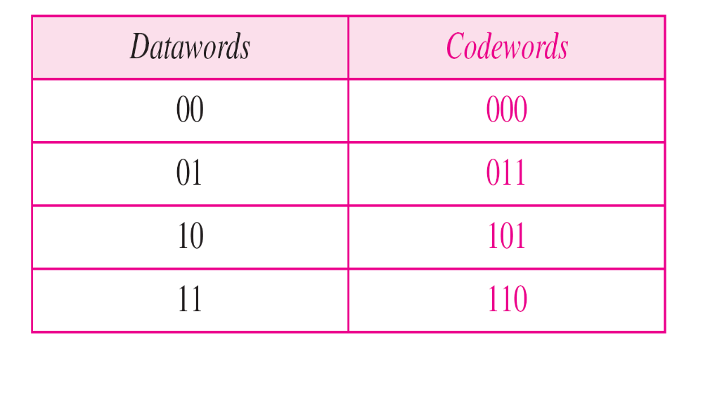
A code for error detection

Slide 20
Note
An error-detecting code can detect
only the types of errors for which it is designed; other types of errors may remain undetected.

Slide 21

Structure of encoder and decoder in error correction

Slide 22
Example
Let us add more redundant bits to
If the receiver can correct an error without knowing what was actually sent.
We add 3 redundant bits to the 2-bit dataword to make 5-bit codewords.
Datawords and codewords. Assume the dataword is 01. The sender creates the codeword 01011.
The codeword is corrupted during transmission, and 01001 is received.
First, the receiver finds that the received codeword is not in the table.
This means an error has occurred. The receiver, assuming that there is only 1 bit corrupted, uses the following strategy to guess the correct dataword.

Slide 23
Example
1. Comparing the received codeword with the first codeword in the table (01001 versus 00000), the receiver decides that the first codeword is not the one that was sent because there are two different bits.
2. By the same reasoning, the original codeword cannot be the third or fourth one in the table.
3. The original codeword must be the second one in the table because this is the only one that differs from the received codeword by 1 bit. The receiver replaces 01001 with 01011 and consults the table to find the dataword 01.

Slide 24

A code for error correction

Slide 25
Note
The Hamming distance between two words is the number of differences between corresponding bits.

Slide 26

Let us find the Hamming distance between two pairs of words.
1. The Hamming distance d(000, 011) is 2 because
2. The Hamming distance d(10101, 11110) is 3 because

Slide 27
Note
The minimum Hamming distance is the smallest Hamming distance between
all possible pairs in a set of words.

Slide 28
Example 10.5
Find the minimum Hamming distance of the coding scheme in Table 10.1.
Solution
We first find all Hamming distances.
The d_{min} in this case is 2.

Slide 29
Find the minimum Hamming distance of the coding scheme in Table 10.2.
Solution
We first find all the Hamming distances.
The d_{min} in this case is 3.

Slide 30
Note
To guarantee the detection of up to s errors in all cases, the minimum
Hamming distance in a block
code must be d_{min} = s + 1.

Slide 31

The structure of the encoder and decoder for a Hamming code

Slide 32

Burst error correction using Hamming code

Slide 33
Cyclic Redundancy Check

Slide 34

CRC encoder and decoder

Slide 35

Division in CRC encoder

Slide 36

Division in the CRC decoder for two cases

